Slide 1
Questions:
How to determine the number of channel to calculate reflectivity curves?
7 channels are used in your script as shown in Fig.1 (next slide). If it is reduced to 2 or 3 channels, this gives better resolution of reflectivity curves, shown in Fig. 4 – 6.
2) Changing the beginning line to calculate reflectivity makes reflectivity curves shift in q. This might be due to
MoveInstrumentComponent(output+"n","DetectorBench",Y=str((118.0-beg)*1.2e-3))
in the procedure “getSpecular”. Is it OK?
3) What is the correct angle for θ=2.3° do we need to apply a slight offset ?
I may have found a bug in mantid. After loading the raw data into a workspace using “Load RAW file” command in Mantid, the data can be displayed in an image or a plot like Fig. 6. But the spectrum number is not consistent with each other.

Slide 2
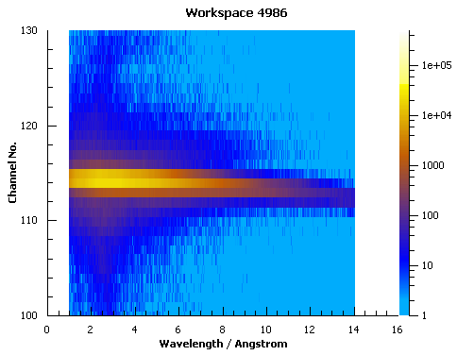
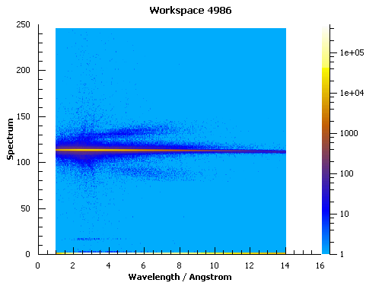
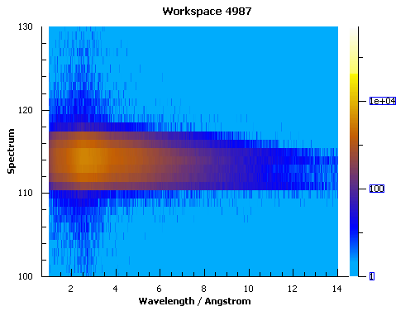
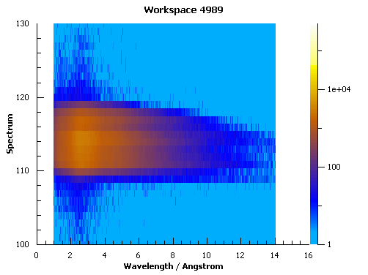
Fig. 1 Images of straight through beam
1st angle (θ=0.5°)
10 μA, Slit area=10 (#4986)
116
Channel number
110
2nd angle (θ=1.6°)
3rd angle (θ=2.3°)

Slide 3
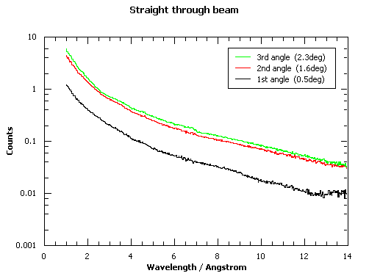
Fig. 2 Profiles of straight through beam
nr.get.mergeThroughBeams("05TB",[4985],[4986],0.03,7.0,106,112)
nr.get.mergeThroughBeams("16TB",[4987],[4988],0.03,7.0,106,112)
nr.get.mergeThroughBeams("23TB",[4989],[4990],0.03,7.0,106,112)
Slit conditions
θ (°) | S1 (mm) | S2 (mm) | S3 (mm) | S4 (mm) | q_{z} (Å⁻¹)
0.5 | 2.33 | 0.33 | --- | 3.0 | ~
0.6 | 2.8 | 0.4 | --- | 3.0 | ~
1.6 | 7.456 | 1.056 | --- | 8.0 | ~
2.3 | 10.7 | 1.53 | --- | 8.0 | ~

Slide 4
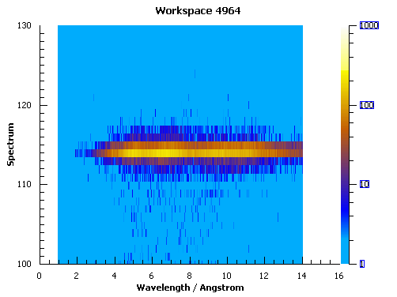
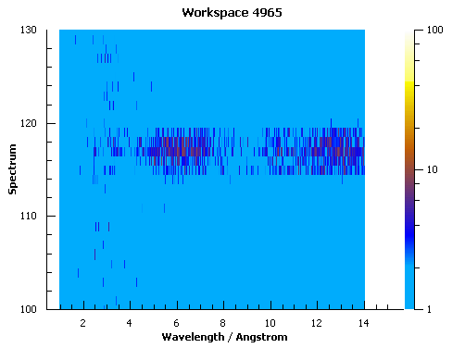
Fig. 3 Images of reflected beam
1st angle (θ=0.5°)
2nd angle (θ=1.6°)
116
110

Slide 5
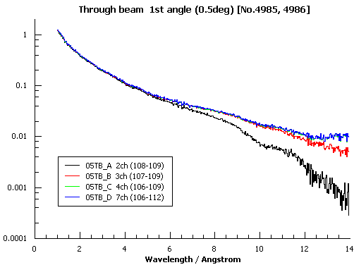
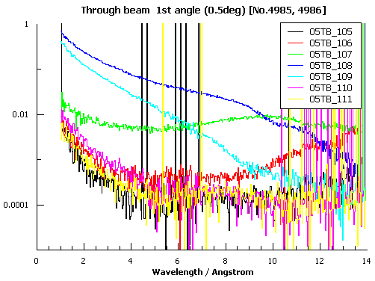
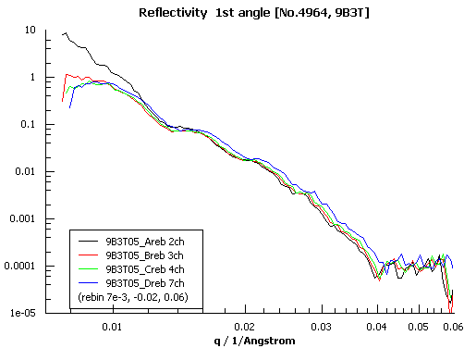
Fig. 4 Profiles of reflected beam (1st angle).
3ch data (107-109) looks fine

Slide 6
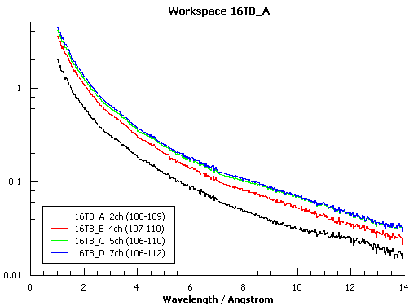
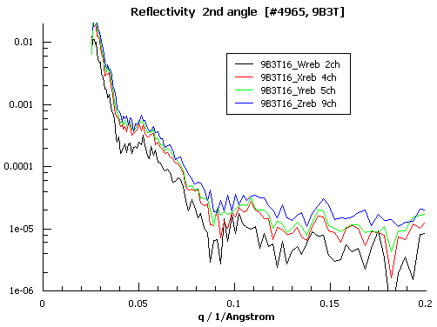
Fig. 4 Profiles of reflected beam (2nd angle).
4ch data (107-110) looks fine

Slide 7
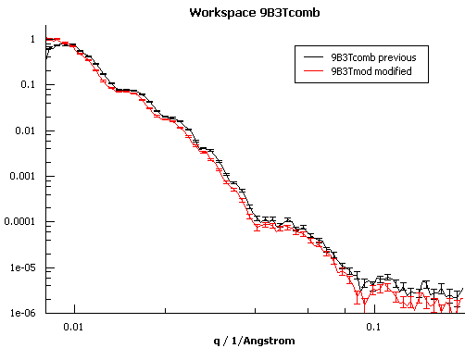
Fig. 5 Combined reflectivity curves
1st / 2nd
9ch / 9ch
3ch / 4ch

Slide 8
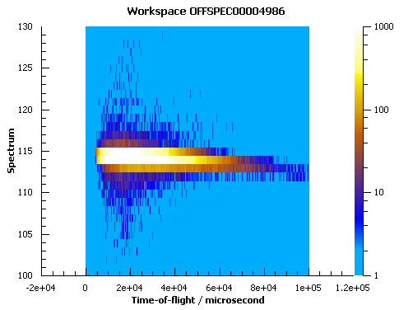
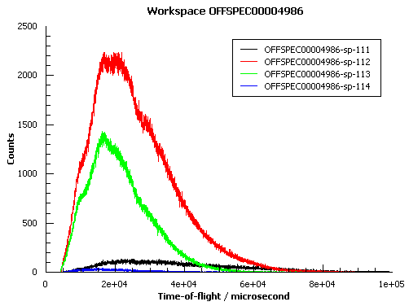
Fig. 6 3D plot and 2D plot of a workspace loaded by Load RAW File command.
Spectrum number seems not to be consistent with each other.

Slide 9
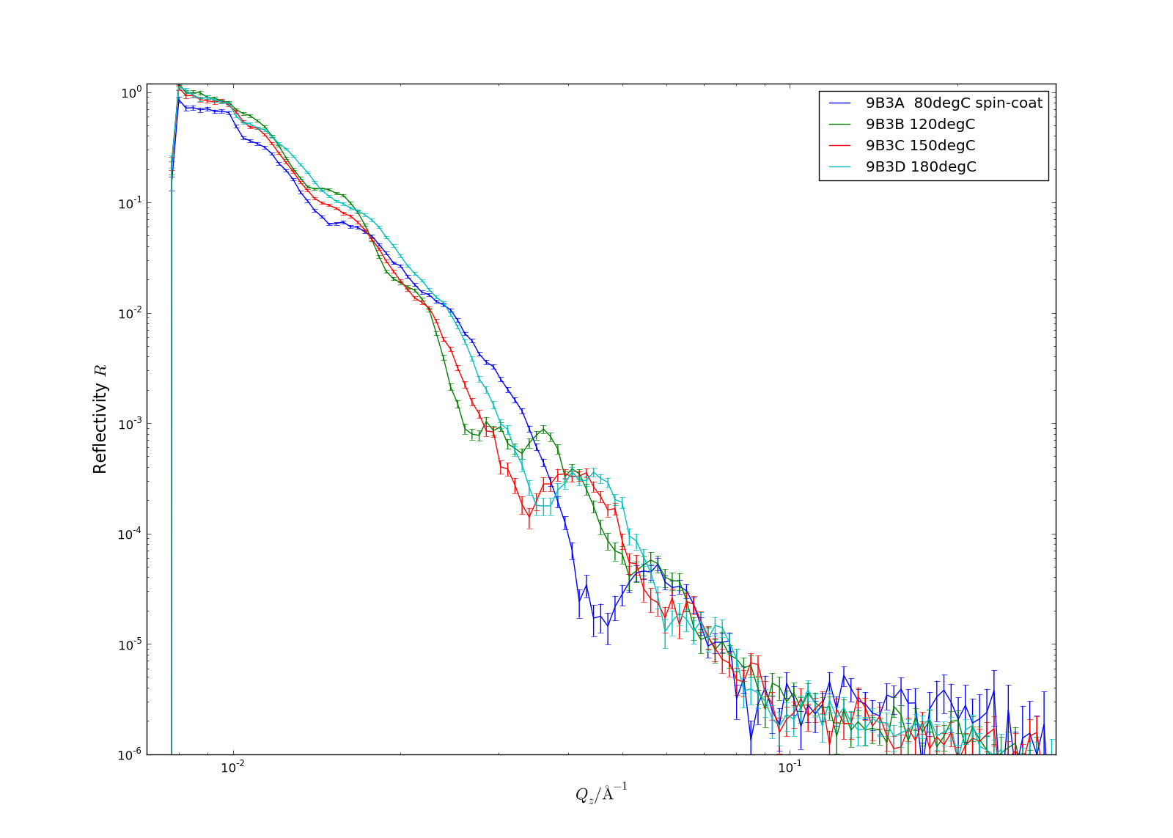
Reflectivities of bilayer samples (spin-coat, F8BT/dTFB/Si)

Slide 10
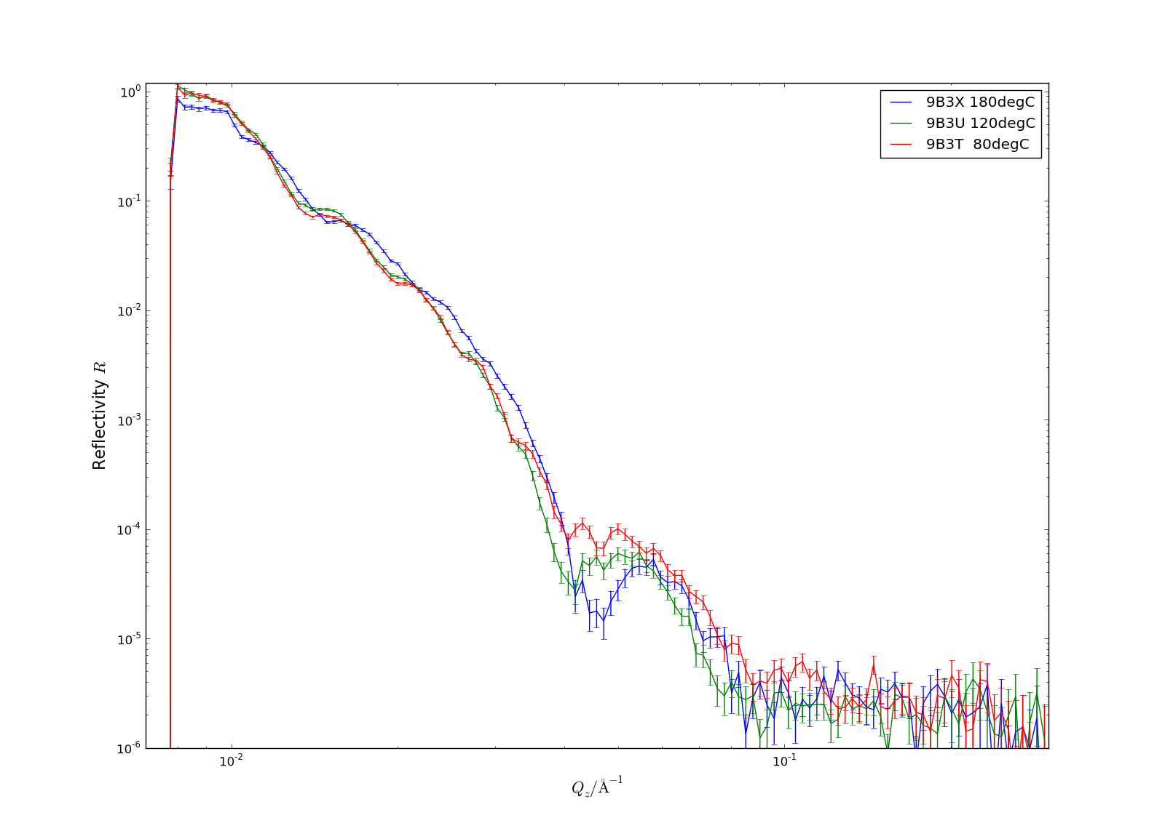
Reflectivities of bilayer samples (floating, F8BT/dTFB/Si)

Slide 11
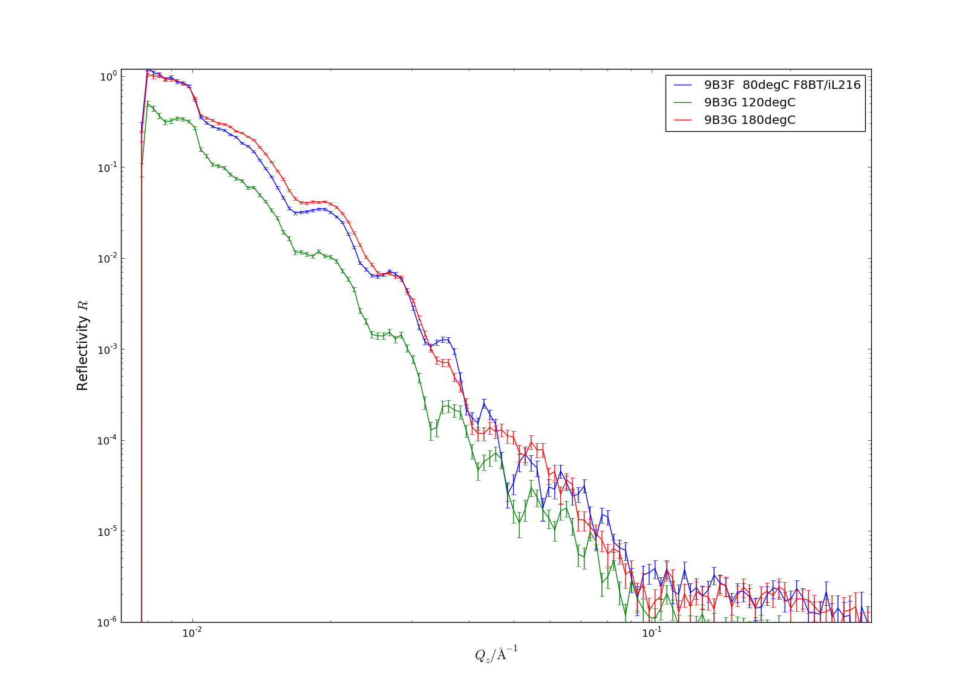
Reflectivities of bilayer samples (spin-coat, F8BT/diL216/Si)

Slide 12
